Slide 1


Sorting Superheroes
Please, join Recycle Smart’s Superhero, Resilience, on her mission to help heal the planet!
Let’s take care of the planet together. By taking responsibility for our actions everyday, we are helping the planet everyday!
Notes:
Lafayette Green Team

Slide 2
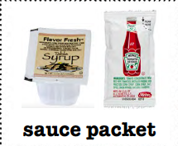

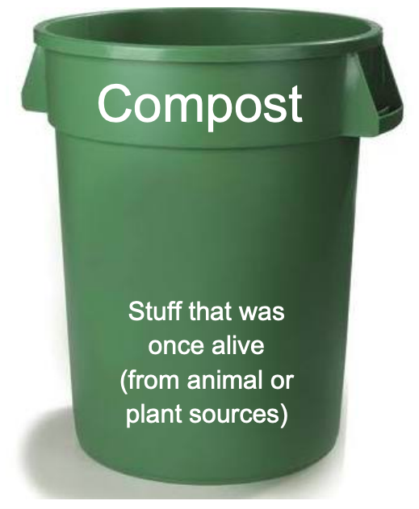


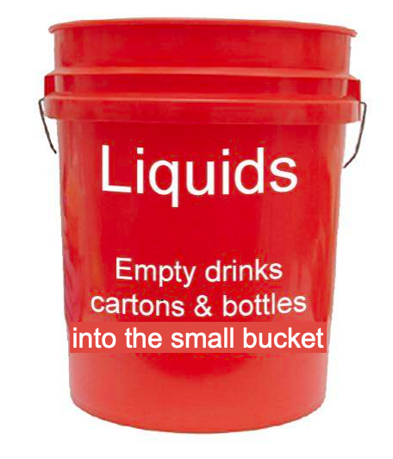
Which bin does this go in?
Notes:
Lafayette Green Team

Slide 3
THE GREY LANDFILL BIN!!!
Notes:
Lafayette Green Team

Slide 4

Which bin does this go in?
Notes:
Lafayette Green Team

Slide 5
THE GREEN COMPOST BIN!!!
Notes:
Lafayette Green Team

Slide 6

Which bin does this go in?
Notes:
Lafayette Green Team

Slide 7
THE BLUE RECYCLE BIN!!!
Notes:
Lafayette Green Team

Slide 8

Which bin does this go in?
Notes:
Lafayette Green Team

Slide 9
THE GREEN COMPOST BIN!!!
Notes:
Lafayette Green Team

Slide 10

Which bin does this go in?
Notes:
Lafayette Green Team

Slide 11
THE GREY LANDFILL BIN!!!
Notes:
Lafayette Green Team

Slide 12

Which bin does this go in?
Notes:
Lafayette Green Team

Slide 13
THE GREY LANDFILL BIN!!!
Notes:
Lafayette Green Team

Slide 14

Which bin does this go in?
Notes:
Lafayette Green Team

Slide 15
THE GREEN COMPOST BIN!!!
Notes:
Lafayette Green Team

Slide 16

Which bin does this go in?
Notes:
Lafayette Green Team

Slide 17
THE FOOD SHARE BIN!!!
Notes:
Lafayette Green Team

Slide 18

Which bin does this go in?
Notes:
Lafayette Green Team

Slide 19
THE GREEN COMPOST BIN!!!
Notes:
Lafayette Green Team

Slide 20

Which bin does this go in?
Notes:
Lafayette Green Team

Slide 21
THE GREEN COMPOST BIN!!!
Notes:
Lafayette Green Team

Slide 22

Which bin does this go in?
Notes:
Lafayette Green Team

Slide 23
THE GREY LANDFILL BIN!!!
Notes:
Lafayette Green Team

Slide 24

Which bin does this go in?
Notes:
Lafayette Green Team

Slide 25
THE BLUE RECYCLE BIN!!!
Notes:
Lafayette Green Team

Slide 26

Which bin does this go in?
Notes:
Lafayette Green Team

Slide 27
THE GREEN COMPOST BIN!!!
Notes:
Lafayette Green Team

Slide 28

Which bin does this go in?
Notes:
Lafayette Green Team

Slide 29
THE GREEN COMPOST BIN!!!
Notes:
Lafayette Green Team

Slide 30

Which bin does this go in?
Notes:
Lafayette Green Team

Slide 31
THE GREY LANDFILL BIN!!!
Notes:
Lafayette Green Team

Slide 32

Which bin does this go in?
Notes:
Lafayette Green Team

Slide 33
THE RED LIQUID BUCKET!!!
Notes:
Lafayette Green Team

Slide 34

Which bin does this go in?
Notes:
Lafayette Green Team

Slide 35
THE BLUE RECYCLE BIN!!!
Notes:
Lafayette Green Team

Slide 36

Which bin does this go in?
Notes:
Lafayette Green Team

Slide 37
THE BLUE RECYCLE BIN!!!
Notes:
Lafayette Green Team

Slide 38

Which bin does this go in?
Notes:
Lafayette Green Team

Slide 39
THE BLUE RECYCLE BIN!!!
Notes:
Lafayette Green Team

Slide 40

Which bin does this go in?
Notes:
Lafayette Green Team

Slide 41
THE RED LIQUID BUCKET!!!
Notes:
Lafayette Green Team

Slide 42

Which bin does this go in?
Notes:
Lafayette Green Team

Slide 43
THE GREY LANDFILL BIN!!!
Notes:
Lafayette Green Team

Slide 44

Which bin does this go in?
Notes:
Lafayette Green Team

Slide 45
THE BLUE RECYCLE BIN!!!
Notes:
Lafayette Green Team

Slide 46

Which bin does this go in?
Notes:
Lafayette Green Team

Slide 47
THE BLUE RECYCLE BIN!!!
Notes:
Lafayette Green Team

Slide 48

Which bin does this go in?
Notes:
Lafayette Green Team

Slide 49
THE FOOD SHARE BIN!!!
Notes:
Lafayette Green Team

Slide 50

Which bin does this go in?
Notes:
Lafayette Green Team

Slide 51
THE GREEN COMPOST BIN!!!
Notes:
Lafayette Green Team

Slide 52

Which bin does this go in?
Notes:
Lafayette Green Team

Slide 53
THE BLUE RECYCLE BIN!!!
Notes:
Lafayette Green Team

Slide 54

Which bin does this go in?
Notes:
Lafayette Green Team

Slide 55
THE GREY LANDFILL BIN!!!
Notes:
Lafayette Green Team

Slide 56

Which bin does this go in?
Notes:
Lafayette Green Team

Slide 57
THE GREY LANDFILL BIN!!!
Notes:
Lafayette Green Team

Slide 58

Which bin does this go in?
Dirty paper
Notes:
Lafayette Green Team

Slide 59
THE GREEN COMPOST BIN!!!
Dirty paper
Notes:
Lafayette Green Team

Slide 60
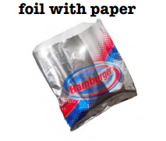
Which bin does this go in?
Notes:
Lafayette Green Team

Slide 61
THE GREY LANDFILL BIN!!!
Notes:
Lafayette Green Team

Slide 62

Which bin does this go in?
Notes:
Lafayette Green Team

Slide 63
THE BLUE RECYCLE BIN!!!
Notes:
Lafayette Green Team

Slide 64

Which bin does this go in?
Notes:
Lafayette Green Team

Slide 65
THE GREY LANDFILL BIN!!!
Notes:
Lafayette Green Team

Slide 66

Which bin does this go in?
Notes:
Lafayette Green Team

Slide 67
THE BLUE RECYCLE BIN!!!
Notes:
Lafayette Green Team

Slide 68

Which bin does this go in?
Notes:
Lafayette Green Team

Slide 69
THE BLUE RECYCLE BIN!!!
Notes:
Lafayette Green Team

Slide 70

Which bin does this go in?
Notes:
Lafayette Green Team

Slide 71
THE GREEN COMPOST BIN!!!
Notes:
Lafayette Green Team

Slide 72

Which bin does this go in?
Notes:
Lafayette Green Team

Slide 73
THE FOOD SHARE BIN!!!
Notes:
Lafayette Green Team

Slide 74

Which bin does this go in?
Notes:
Lafayette Green Team

Slide 75
THE GREY LANDFILL BIN!!!
Notes:
Lafayette Green Team

Slide 76

Which bin does this go in?
Notes:
Lafayette Green Team

Slide 77
THE BLUE RECYCLE BIN!!!
Notes:
Lafayette Green Team

Slide 78

Which bin does this go in?
Notes:
Lafayette Green Team

Slide 79
THE GREEN COMPOST BIN!!!
Notes:
Lafayette Green Team

Slide 80

Which bin does this go in?
Notes:
Lafayette Green Team

Slide 81
THE BLUE RECYCLE BIN!!!
Notes:
Lafayette Green Team

Slide 82

Which bin does this go in?
Notes:
Lafayette Green Team

Slide 83
THE RED LIQUID BUCKET!!!
Notes:
Lafayette Green Team

Slide 84

Which bin does this go in?
Notes:
Lafayette Green Team

Slide 85
THE BLUE RECYCLE BIN!!!
Notes:
Lafayette Green Team

Slide 86

Which bin does this go in?
Notes:
Lafayette Green Team

Slide 87
THE GREEN COMPOST BIN!!!
Notes:
Lafayette Green Team

Slide 88

Which bin does this go in?
Notes:
Lafayette Green Team

Slide 89
THE FOOD SHARE BIN!!!
Notes:
Lafayette Green Team

Slide 90

Which bin does this go in?
Notes:
Lafayette Green Team

Slide 91
THE GREY LANDFILL BIN!!!
Notes:
Lafayette Green Team

Slide 92

Which bin does this go in?
Notes:
Lafayette Green Team

Slide 93
THE FOOD SHARE BIN!!!
Notes:
Lafayette Green Team

Slide 94

Which bin does this go in?
Notes:
Lafayette Green Team

Slide 95
THE GREY LANDFILL BIN!!!
Notes:
Lafayette Green Team

Slide 96

Which bin does this go in?
Notes:
Lafayette Green Team

Slide 97
THE GREY LANDFILL BIN!!!
Notes:
Lafayette Green Team

Slide 98

Which bin does this go in?
Notes:
Lafayette Green Team

Slide 99
THE GREEN COMPOST BIN!!!
Notes:
Lafayette Green Team

Slide 100

Which bin does this go in?
Notes:
Lafayette Green Team

Slide 101
THE GREEN COMPOST BIN!!!
Notes:
Lafayette Green Team

Slide 102
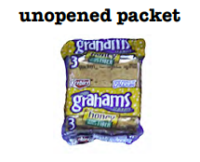
Which bin does this go in?
Notes:
Lafayette Green Team

Slide 103
THE FOOD SHARE BIN!!!
Notes:
Lafayette Green Team

Slide 104
Thank you for taking care of the planet!
You are now a
Sorting Superhero Expert!
Notes:
Lafayette Green Team

